Slide 1

Haldia Institute of Technology
Study and Performance Analysis of QOS Parameters in Cloud Networking Platform
Presented by
Under the supervision of
Sagarika Hembrem (18/ECE/038)
Soumik Sil (18/ECE/020)
Shaheer Alam (18/ECE/029)
Sayan Mandal (18/ECE/031)
Neha Rani (18/ECE/060)
Dr. Suman Paul
Assistant Professor
ECE Dept
Electronics and Communication Department

Slide 2
ACKNOWLEDGEMENT
Firstly, we would like to thank Dr. Suman Paul for his constant guidance and support in the project. Without his help the completion of this project would have been impossible.
Next we would also like to share our sincere gratitude to our college, Haldia Institute of Technology for providing the opportunity to work on this project.
Finally, we would like to thank each and everyone for their contribution in successfully completing this project thesis.
Study and Performance Analysis of QOS Parameters in Cloud Networking Platform
2

Slide 3
CONTENTS
Objective
What Is QOS
What Is VoIP
Simulation
-- Data Collection
-- Data Preprocessing
-- Modelling
Result
Key Findings
Study and Performance Analysis of QOS Parameters in Cloud Networking Platform
3

Slide 4
OBJECTIVE
Voice over IP (VoIP) is a real time application that allows transmitting voice through the Internet network. Recently, there has been amazing progress in this field due to the advances in hardware and breakthrough algorithms. As a result, the quality of VoIP calls has improved considerably. However, the quality of VoIP calls under extreme conditions of QoS impairments still remains a problem that needs to be addressed.
This project report concentrates in making an analysis of the effects that these QoS impairments such as delay, jitter, and packet loss have in the quality of VoIP calls.
Additionally, we will use Machine Learning approach to solve this problem by developing a Machine Learning model which optimizes QoS parameters to enhance the quality of VoIP calls.
Study and Performance Analysis of QOS Parameters in Cloud Networking Platform
4

Slide 5
WHAT IS QOS ?
Quality of service (QoS) refers to any mechanism that manages data traffic to reduce packet loss, latency and jitter on a network.
QoS can be measured by the following parameters:
Packet loss - is the percentage of packets that are not received at the destination.
Delay - is the time taken by a packet to travel from source to destination.
Jitter - is the variation in delay of packets.
Bandwidth - is the maximum amount of data that a network communication link can transmit in a given amount of time.
Study and Performance Analysis of QOS Parameters in Cloud Networking Platform
5

Slide 6
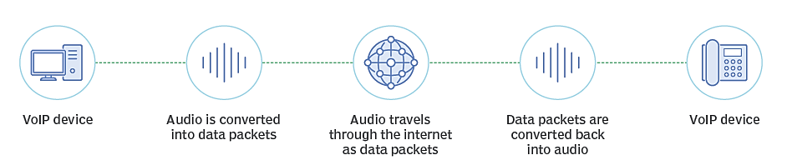
WHAT IS VOICE OVER IP (VoIP)?
VoIP (Voice-over Internet Protocol) is the transmission of voice over internet connection instead of local telephone company. VoIP converts the sender’s voice into a digital signal, compresses it, and sends it over the internet. On the receiving end, the digital data is then uncompressed into sound.
VoIP is useful for both consumers and businesses as it includes features like:
Call recording
Voicemail to e-mail
Auto forwarding
Address book
Unified communication
Fig : Working of VoIP
Study and Performance Analysis of QOS Parameters in Cloud Networking Platform
6

Slide 7
SIMULATION
Data Collection
QoS dataset is generated which focuses on VoIP traffic parameters. It comprises of 204 samples and 8 features
- packet loss rate, jitter, delay, a, effective delay, R, final R and Mean Opinion Score (MOS).
The samples for packet loss rate, jitter and delay are taken such that their values are within the acceptable limits for VoIP.
Effective delay is calculated using delay, jitter and ‘a’.
‘a’ is a factor which varies between 1.5 to 2.
R is calculated from effective delay
Final R is calculated from R and packet loss rate
MOS is calculated from final R
Table: Acceptable range for VoIP
FEATURE | RANGE
Packet Loss Rate | 0.001% to 0.03%
Jitter | 0.01 ms to 5 ms
Delay | 1 ms to 20 ms
Study and Performance Analysis of QOS Parameters in Cloud Networking Platform
7

Slide 8
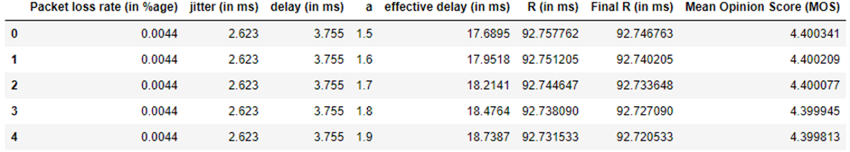
Data Preprocessing
Fig: First 5 rows of QoS dataset
The redundant features (effective delay, R and final R) are removed from the dataset.
The input features are packet loss rate, jitter, delay and a. The output feature is MOS.
Dataset is split into training set and testing set in 75:25 ratio.
Then both the training and testing set are standardized such that mean = 0 and standard deviation = 1
Study and Performance Analysis of QOS Parameters in Cloud Networking Platform
8

Slide 9
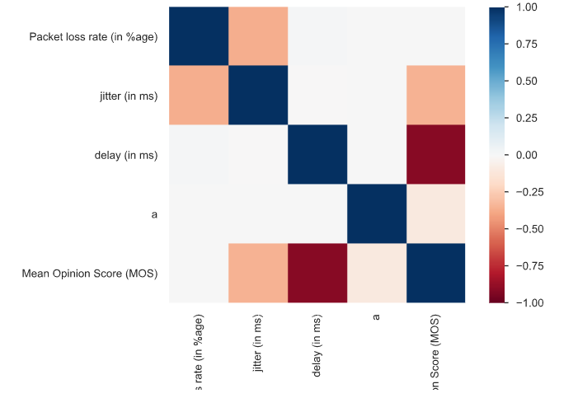
It can be seen from the fig that
delay has the highest correlation with MOS
Packet loss rate has the least correlation with MOS
Packet loss, jitter, delay and factor ‘a’ has little to no correlation with each other
Fig : Spearman’s correlation among the features
Study and Performance Analysis of QOS Parameters in Cloud Networking Platform
9

Slide 10
Modelling
1. Linear Regression:
Linear Regression model can be represented by :
y = a₀ + a₁ x₁ + a₂ x₂ + ……. + a_{n} x_{n}
After applying LR algorithm to our data, we obtained the following values of intercept and coefficients.
Table: Values of intercept and coefficients
Intercept | 4.395731072042288
Coefficient of packet loss rate | -0.00039892
Coefficient of jitter | -0.00118707
Coefficient of delay | -0.00320489
Coefficient of a | -0.00022948
So our Linear regression model can be represented as –
MOS = 4.3957 – (0.00039892 * packet loss rate + 0.00118707 * jitter + 0.00320489 *delay + 0.00022948 * a)
Study and Performance Analysis of QOS Parameters in Cloud Networking Platform
10

Slide 11
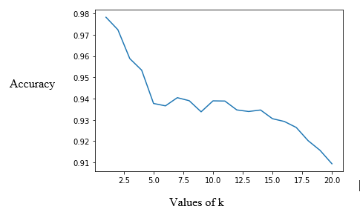
2. K-Nearest Neighbours :
We find the optimal value of k (number of neighbours) by plotting a graph for values of k and their corresponding accuracies.
Then, the distance between the new point and each of the training points is calculated.
The closest 2 data points are selected based on the distance from the new point.
The average of these 2 data points is the final prediction for the new point.
Fig : Plot for finding value of k
Study and Performance Analysis of QOS Parameters in Cloud Networking Platform
11

Slide 12
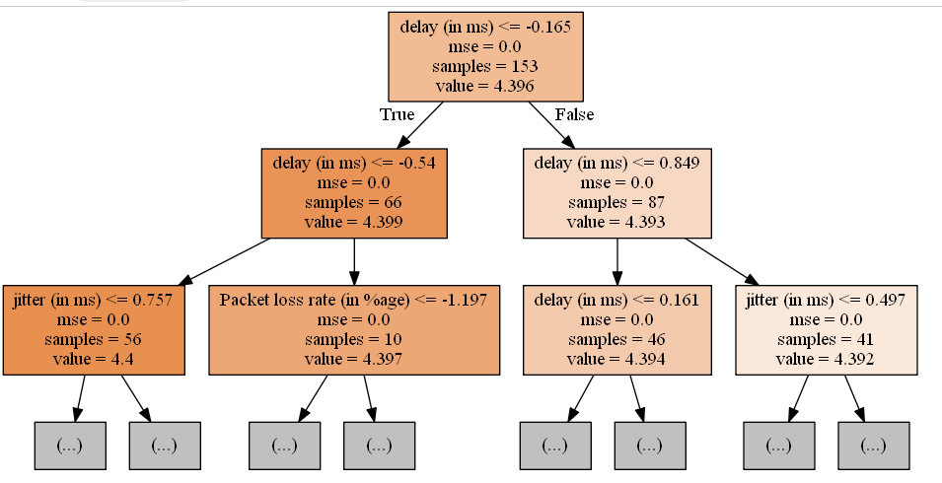
3. Decision Tree:
We find the input feature to split the dataset into 2 parts, so that the Mean Squared Error (MSE) is minimized.
This process is continued iteratively until the max_depth is reached.
By hyper-parameter tuning, we found max_depth = 5 gives the optimal result.
Fig : Structure of decision tree model
with max_depth = 2
Study and Performance Analysis of QOS Parameters in Cloud Networking Platform
12

Slide 13
4. Gradient Descent:
We calculate MSE (cost) at coefficients (m) = 0 and intercept (c) = 0.
Next the value of m and c is reduced by the learning rate. There will be a decrease in MSE (cost).
These steps will be repeated until we reach the given number of iterations.
By taking number of iterations = 70 and learning rate = 0.1, the following values for m (coefficient) and c (intercept) are obtained:
Table: Values of intercept and coefficients
Intercept | 4.395730348732736
Coefficient of packet loss rate | -0.00033312
Coefficient of jitter | -0.00112119
Coefficient of delay | -0.00320633
Coefficient of a | -0.00023265
Study and Performance Analysis of QOS Parameters in Cloud Networking Platform
13

Slide 14
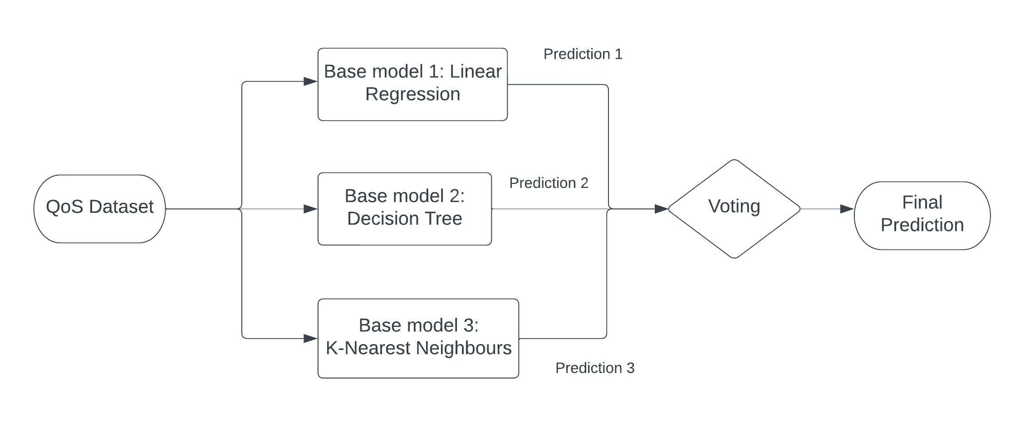
5. Voting Ensemble:
For our Voting model, we have taken 3 base models – Linear Regression model, Decision tree model and KNN model.
The voting ensemble will fit the QoS dataset on each of these base models.
Then it averages the predictions made by each of the base models to form final prediction.
Fig: Voting Ensemble block diagram
Study and Performance Analysis of QOS Parameters in Cloud Networking Platform
14

Slide 15
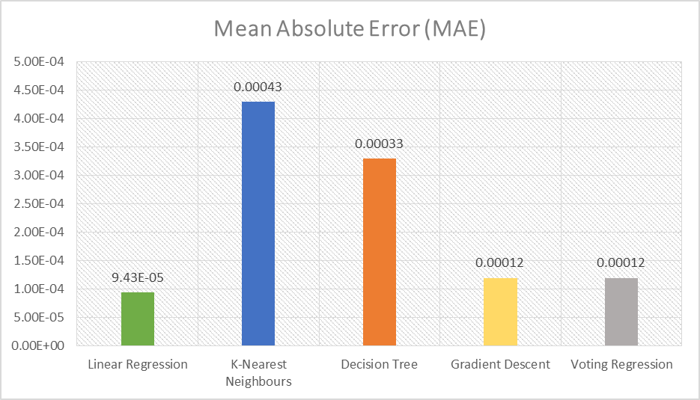
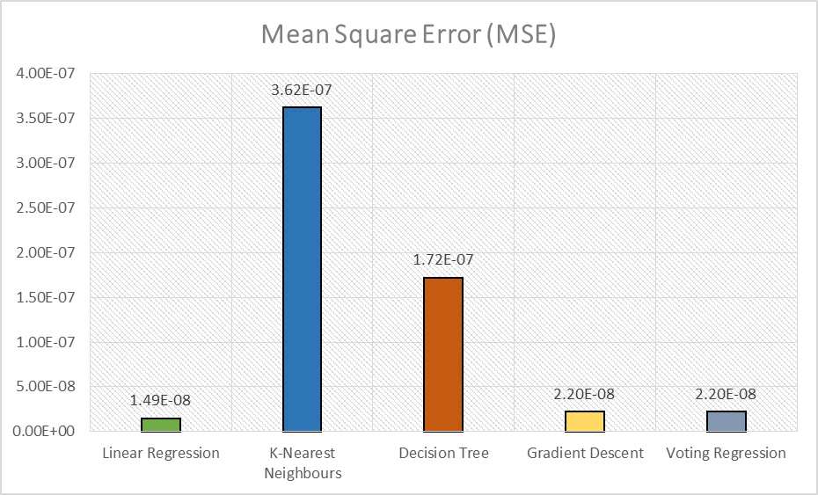
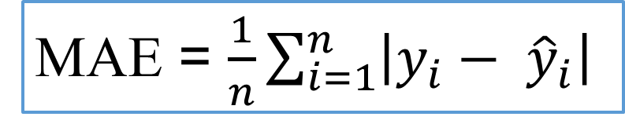
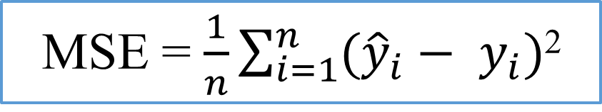
RESULT
Fig : Comparison of models based on MAE
Fig : Comparison of models based on MSE
MAE = $\frac{1}{n}\sum_{i=1}^{n}{\left|y_{i}− {\hat{y}}_{i}\right|}$
MSE = $\frac{1}{n}\sum_{i=1}^{n}{({\hat{y}}_{i}− y_{i}})$²
Study and Performance Analysis of QOS Parameters in Cloud Networking Platform
15

Slide 16
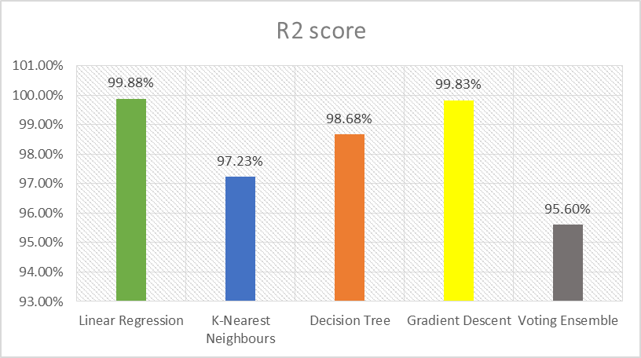
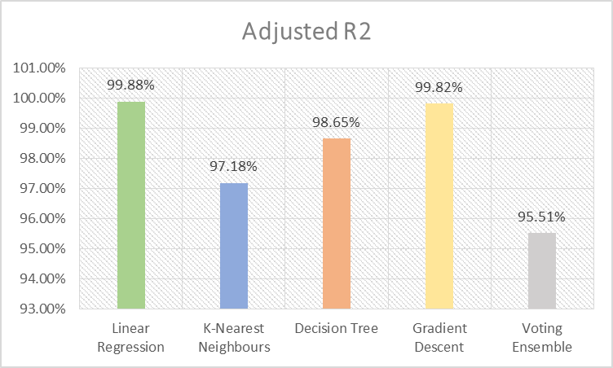
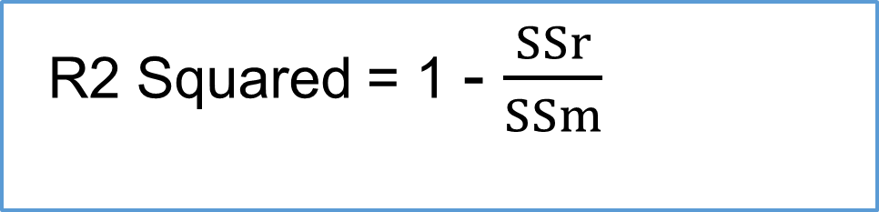
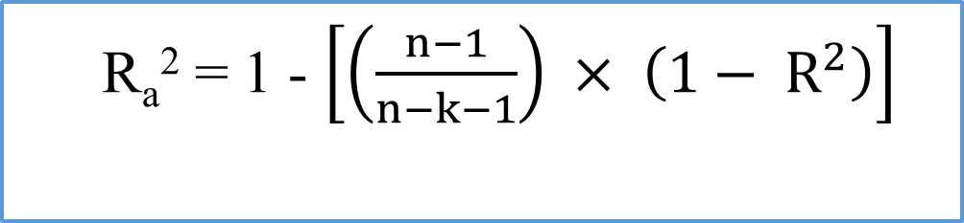
Fig : Comparison of models based on R2
Fig : Comparison of models based on Adjusted R2
R2 Squared = 1 - $\frac{SSr}{SSm}$
R_{a}² = 1 - $\left[\left(\frac{n−1}{n−k−1}\right) × \left(1− R^{2}\right)\right]$
Study and Performance Analysis of QOS Parameters in Cloud Networking Platform
16

Slide 17
KEY FINDINGS
The results revealed that Linear Regression model gives the best accuracy among all the models.
The feature importance based on Linear Regression indicated that delay has the highest significance in developing the model, followed by jitter and packet loss has the least significance.
The accurate predictions made by the LR model is due to the high negative correlation between MOS and delay and absence of multi-collinearity.
These findings show that machine learning approaches have potential in determining the QoS parameters and hence can be used to improve the quality of VoIP calls.
Study and Performance Analysis of QOS Parameters in Cloud Networking Platform
17

